Slide 1
Probability
EQ: How can I visual displays to calculate probabilities?

Slide 2
Probability EQ – How can I use visual displays to calculate probabilities?
Task:
From a class of 30 students 12 played cricket (C), 14 played netball(N) and 6 played both.
Represent this information in a two way table
How many students play neither?
Find the probability that a pupil chosen at random plays netball only.
Find the probability that a student who plays netball also plays cricket.

Slide 3
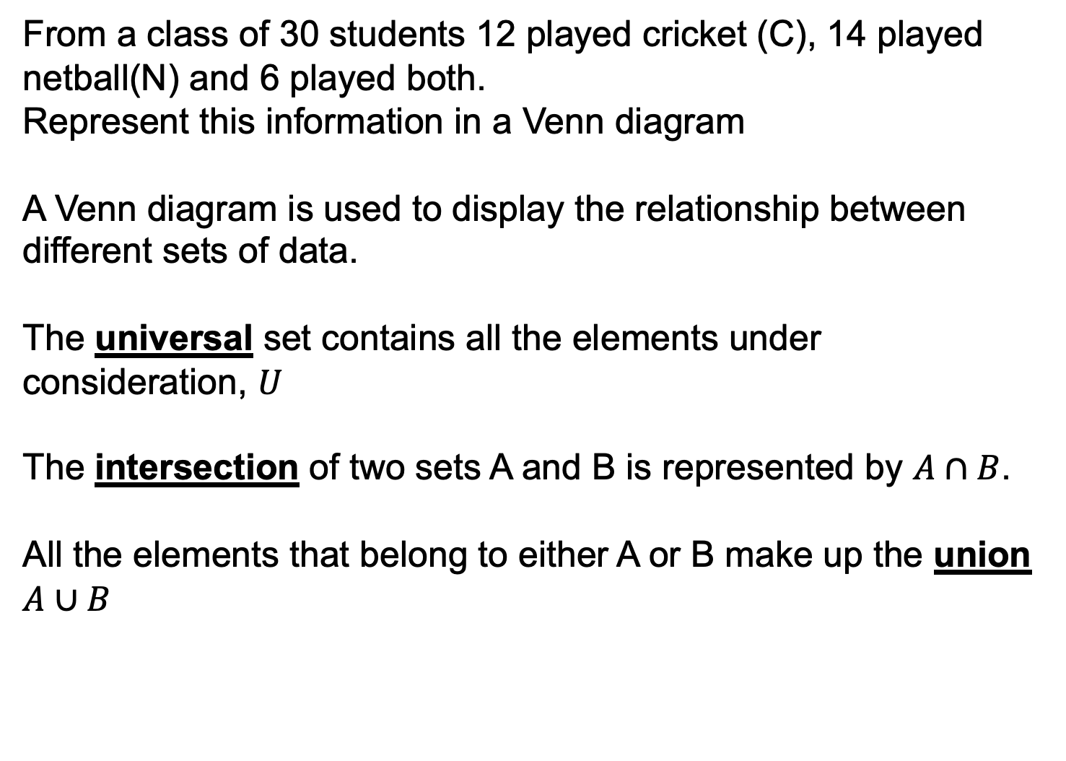
Probability EQ – How can I use visual displays to calculate probabilities?
From a class of 30 students 12 played cricket (C), 14 played netball(N) and 6 played both.
Represent this information in a Venn diagram
A Venn diagram is used to display the relationship between different sets of data.
The universal set contains all the elements under consideration, $U$
The intersection of two sets A and B is represented by $A∩B$.
All the elements that belong to either A or B make up the union $A∪B$

Slide 4
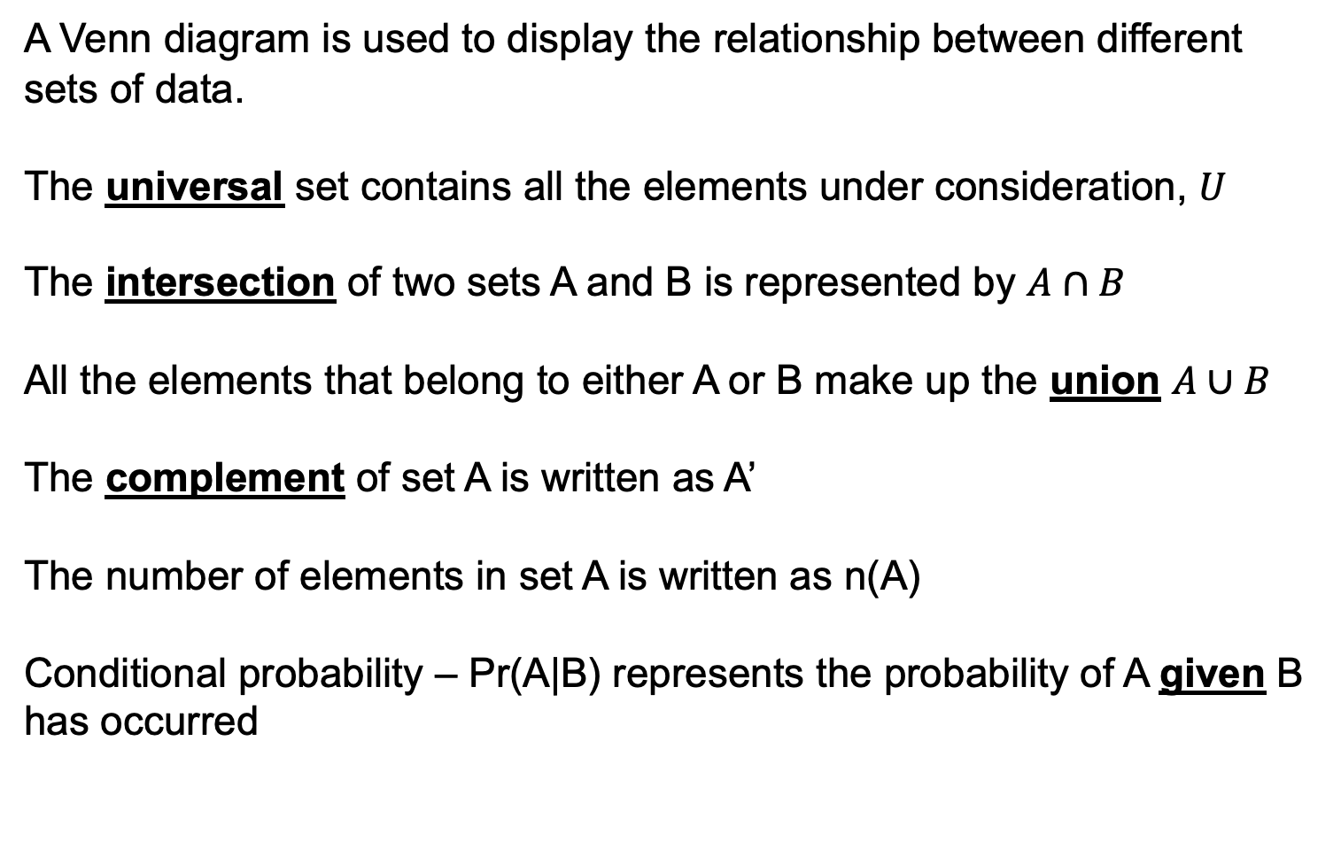
Probability EQ – How can I use visual displays to calculate probabilities?
A Venn diagram is used to display the relationship between different sets of data.
The universal set contains all the elements under consideration, $U$
The intersection of two sets A and B is represented by $A∩B$
All the elements that belong to either A or B make up the union $A∪B$
The complement of set A is written as A’
The number of elements in set A is written as n(A)
Conditional probability – Pr(A|B) represents the probability of A given B has occurred

Slide 5
Venn diagrams and set notation
U or E
U or E is the universal set, i.e. everything we’re interested in.
The sample space is all the elements of a particular set, listed like this:
The elements (members) of set A:
A = { }
The number of elements in a set is listed as:
The number of elements in A, n(A) =
A
B
Ex: If A is the set of prime numbers and B is the set of even numbers, place the numbers 1 to 20 on the diagram.
The elements of set A are: A = { }
The number of elements in A, n(A) =

Slide 6
Intersect and union symbols
Imagine that you have two blank copies of the same Venn diagram printed on transparent sheets:
A
B
A
A
B
Shade the relevant parts of each diagram:
B
A
A
B
Now lay the diagrams on top of each other:
B
A
B
A
B
A U B (A union B, A or B)
is the whole area where there is ANY shading
- think U for Union
A
B
A ∩ B (A intersect B, A and B)
is the area where BOTH layers are shaded
- think of the ∩ as the N in iNtersection or aNd
Now try this method to decide what A’ U B and A’ ∩ B will look like.
(A’ means “not A”, i.e. everything except A.)
A
B
A
B
Answers:

Slide 7
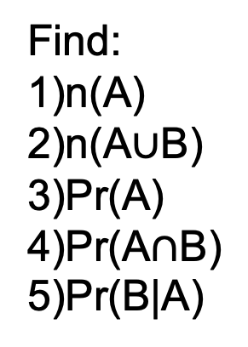
Probability EQ – How can I use visual displays to calculate probabilities?
A
B
Find:
n(A)
n(A$∪$B)
Pr(A)
Pr(A$∩$B)
Pr(B|A)
8
5
2
9

Slide 8
Set notation with Venn diagrams
1. Shade the diagrams to
match the descriptions
2. Describe the shaded areas
using set notation
Basic definitions
A
B
A
B
A
B
A
B
A
B
A’
Complement of A
Not A
A
B
A
B
A ∩ B’
A
B
A U B
Union, or
(at least 1)
A
B
A
B
A U B’
A
B
A ∩ B
Intersect, and
(both)
A
B
A
B
A U A’
Question
In a group of 100 students, 50 study Maths, 29 study Biology, and 13 study both.
Draw a Venn diagram and use it to find:
P(M) = P (M’) = P(B) = P(B’) =
P(M ∩ B) = P(M U B) = P(M ∩ B’) =
Extension: make up some more of your own.
M
B

Slide 9
Set notation with Venn diagrams – answers
1. Shade the diagrams to
match the descriptions
2. Describe the shaded areas
using set notation
Basic definitions
A
B
A
A
B
B
A
B
A
B
B’
A
B
A’
Complement of A
Not A
A
A
B
B
A
B
A’ ∩ B’
or (A U B)’
A ∩ B’
A
B
A U B
Union, or
(at least 1)
A
A
B
B
A
B
A’ U B’
or (A ∩ B)’
A U B’
A
B
A ∩ B
Intersect, and
(both)
A
A
B
B
A
B
A U A’
A’ U B
Question
In a group of 100 students, 50 study Maths, 29 study Biology, and 13 study both.
Draw a Venn diagram and use it to find:
P(M) = 50/100 = 0.5 P (M’) = 50/100 = 0.5 P(B) = 29/100 = 0.29 P(B’) = 71/100 = 0.71
P(M ∩ B) = 13/100 = 0.13 P(M U B) = 66/100 = 0.66 P(M ∩ B’) = 37/100 = 0.37
Extension: make up some more of your own.
M
B
37
13
16
34

Slide 10
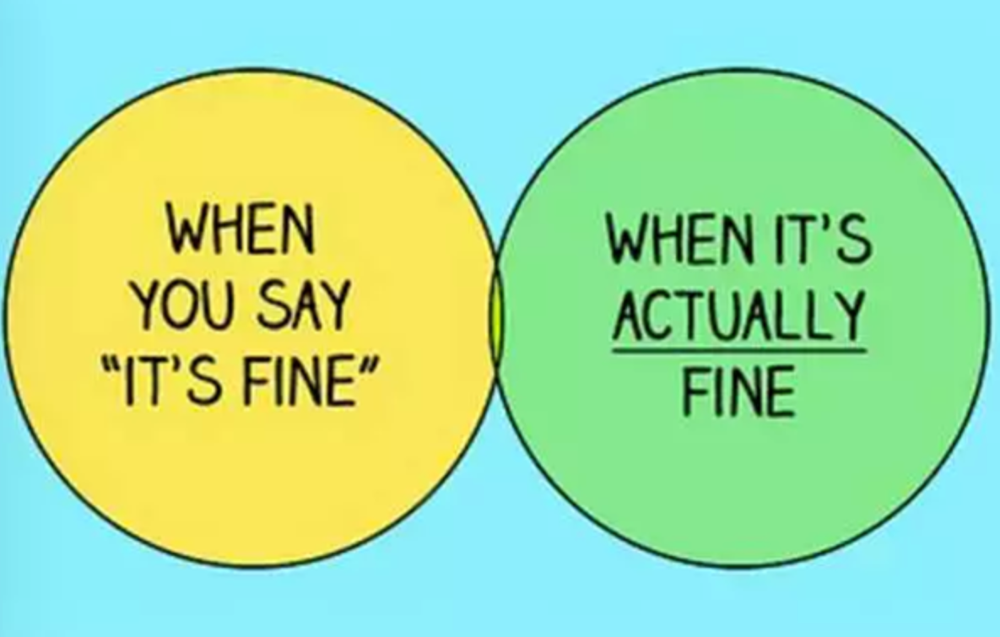
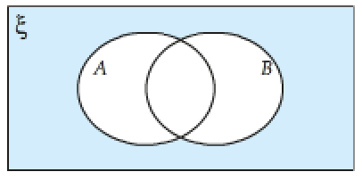







What have we learnt?
Which section represents A?
Which section represents B?
Which section represents A or B?
Which section represents A and B?
Which section represents A but not B?
Which section represents B but not A?
Which section represents neither A or B?

Slide 11
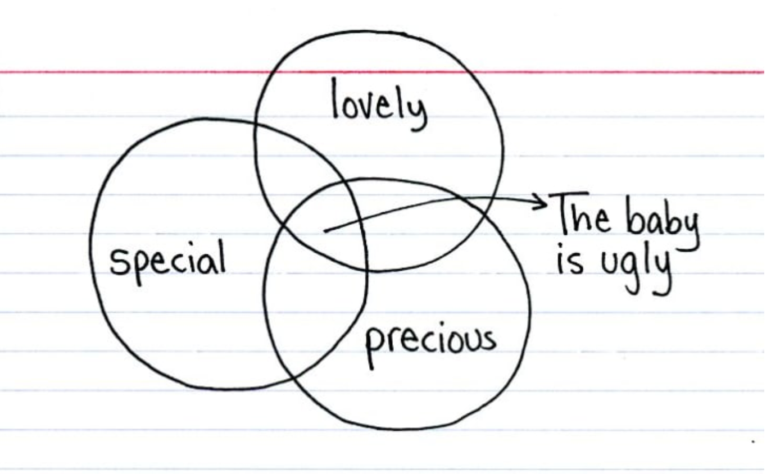
What have we learnt?

Slide 12
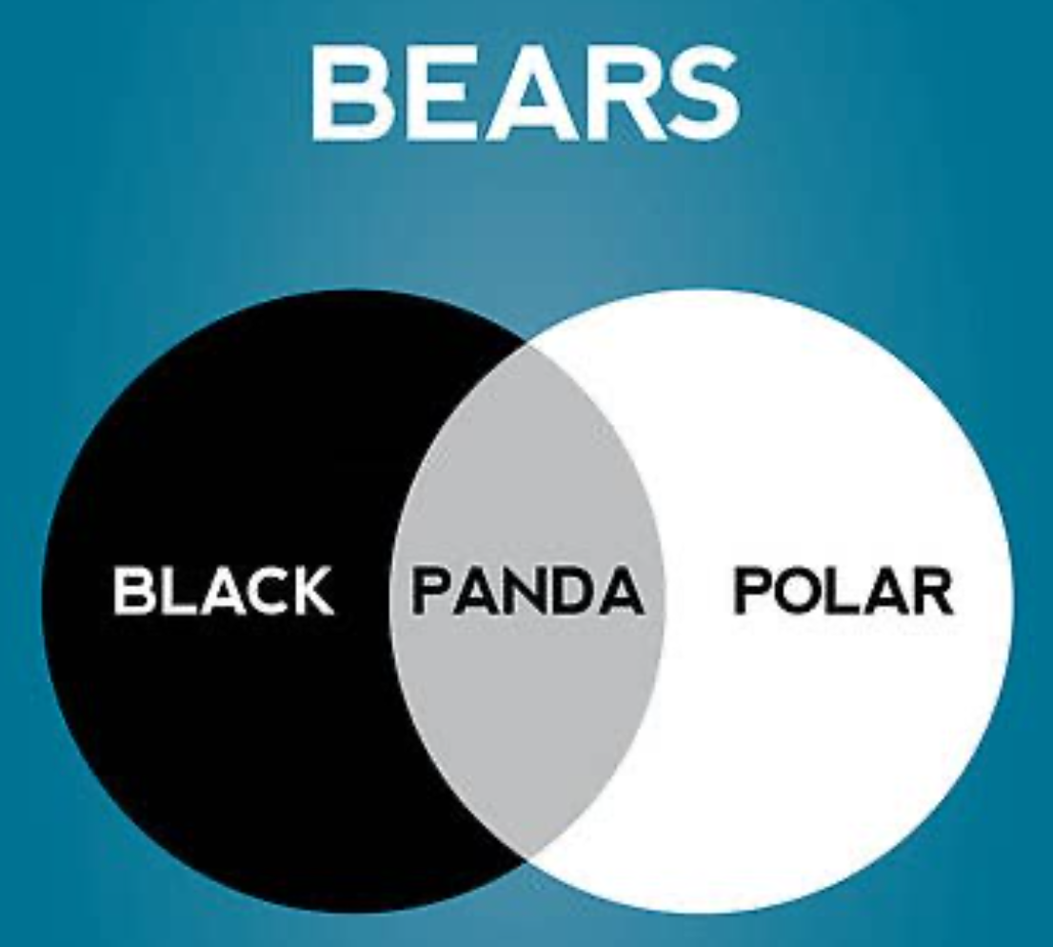
What have we learnt?

Slide 13
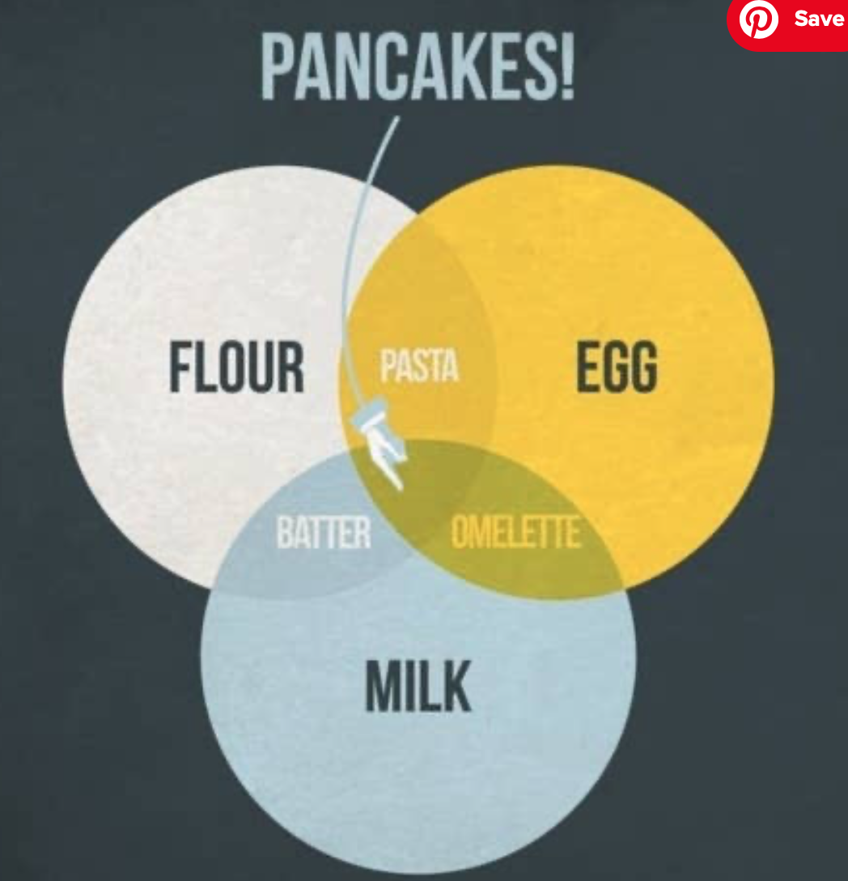
What have we learnt?

Slide 14
Two-way tables
Fill in the blanks in this table showing ice-cream flavour preferences.
 | Choc | Strawb | Vanilla | Total
Male | 5 |  |  | 28
Female |  |  | 10
Total | 20 | 16 | 24 | 60
9
14
15
7
32
Can you see how addition law is applied here?
Now work out:
1. P(C) = 2. P(F) =
3. P(C∩F) = 4. P(CUF) =
5. P(C’) = 6. P(C’∩F) =
7. P(C’UF) = 8. P(C’UF’) =
20/60 = 1/3
32/60 = 8/15
15/60 = 1/4
(32+5)/60 = 37/60
(16+24)/60 = 2/3
(7+10)/60 = 17/60
(32+9+14)/60 = 11/12
1 - 15/60 = 3/4

Slide 15
Class two-way table
Use this table to find probabilities relating to your schoolmates’ preferred subjects.
 | English | Science | PE | Total
Girls
Boys
Total
Now work out:
P(Girls) = P(E) =
P(Boys∩P) = P(BoysUP) =
P(S’) = P(S’∩Girls) =
P(S’UGirls) = P(S’UGirls’) =

